Slide 1

PRODUCT AUTHENTICATION
USING BLOCKCHAIN
Abhishek Singh Yadav (2000290120011)
Aditi Batra (2000290120012)
Anurag Tripathi (2000290120036)

Slide 2
INTRODUCTION
Product certification can reflect product quality, maintain product reputation, and protect the legitimate rights and interests of consumers. However, with the continuous increase in the number and types of products sold by online platforms, the possibility of consumers buying fake and shoddy products has gradually increased. This violates the consumers’ legitimate rights and interests and leads consumers to question product brand reputation. Hence, the market demand for product certification is constantly increasing.
Currently, blockchains are widely used in different application scenarios, such as product certification, the Internet of Things, supply chain, and smart cities to ensure data security and traceability. Blockchains are distributed and decentralized databases. On a blockchain, both parties do not need to reach a consensus or rely on third-party agencies to conduct transactions. The transactions on the chain are traceable, undeniable, and nonmodifiable, which can well ensure the credibility of transactions.
In this project, we came up with the idea of using unbreachable blockchain technology to verify or authenticate the credibility of a product. For which we will store the information of the product, based on the blockchain technology and let the consumer view that the product they are about to use is legitimate or not

Slide 3
PROBLEM STATEMENT
During the study for the project, we got acknowledged to various scenarios where the unauthenticated false products are handed to the consumer. Also, it is recognizable that people found themselves helpless when they are exposed to such conditions. So, by this project we aim to authenticate the product using the blockchain technology.

Slide 4
OBJECTIVE
The main objective of this project is to authenticate a product.
Other specific objectives are
This will reduce the number of false products in the market.
The image of company will not be tarnished.
Producer-consumer relation will be better.
Consumer will have the complete information about the product.

Slide 5
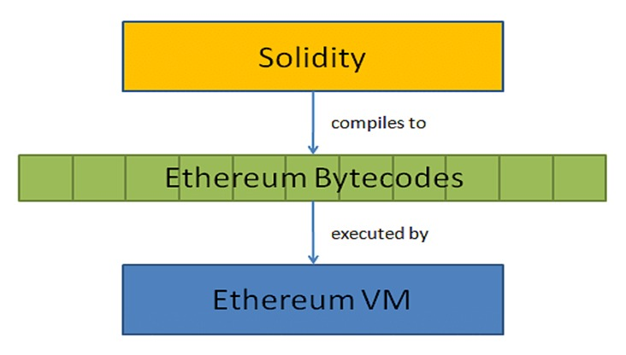
PROPOSED METHODOLOGY
Algorithm:
Register the product.
Login Using the correct credentials.
Add all the necessary information about the product.
Generate accessible link of the product that will confirm the authenticity of the product and provides read only access of the information added about the product.
Consumer can access the link and check if the product is authentic or not.
If product is found to be authentic, they can also view all the information added to the product

Slide 6
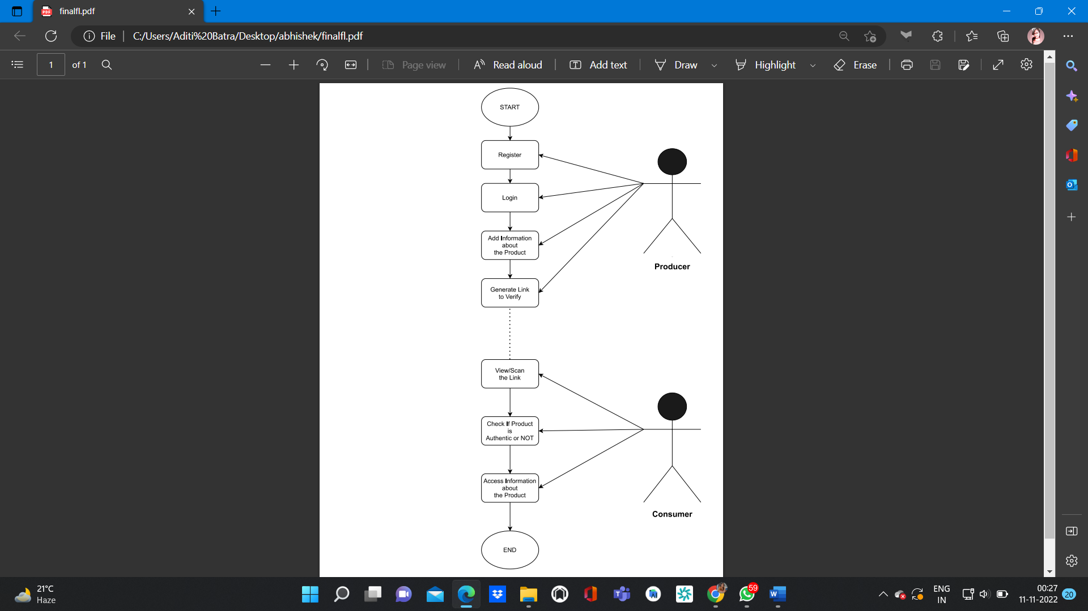

Slide 7
TECHNOLOGY USED
Blockchain
Solidity
Web3.JS
Blockchain is a system of recording information in a way that makes it difficult or impossible to change, hack, or cheat the system. A blockchain is essentially a digital ledger of transactions that is duplicated and distributed across the entire network of computer systems on the blockchain. Ethereum is a blockchain-based computing platform that enables developers to build and deploy decentralized applications—meaning not run by a centralized authority. You can create a decentralized application for which the participants of that particular application are the decision-making authority.
It is an object-oriented programming language for implementing smart contracts on various blockchain platforms. It is the primary language on Ethereum as well as on other private blockchains such as the enterprise-oriented Hyperledger Fabric blockchain. It's used to create smart contracts that implement business logic and generate a chain of transaction records in the blockchain system. It acts as a tool for creating machine-level code and compiling it on the Ethereum Virtual Machine (EVM)
Web3 is a collection of JS libraries that lets you interact with an Ethereum node remotely or locally. Simply, it provides us with an API to use so we can easily work with the blockchain. Web3 works as a wrapper for JSON RPC to connect to a remote or local Ethereum node with either a HTTP or IPC connection.

Slide 8
CHALLENGES
Scalability
Privacy Leakage
Selfish Mining
With the increasing number of transactions, the blockchain becomes heavy. Currently, Bitcoin blockchain has exceeded 100 GB storage. All transactions have to be stored for validating the transaction. Besides, due to the original restriction of block size and the time interval used to generate a new block, the Bitcoin blockchain can only process nearly 7 transactions per second, which cannot fulfil the requirement of processing millions of transactions in a real-time fashion.
The blockchain is believed to be very safe as users only make transactions with generated addresses rather than real identity. Users also could generate many addresses in case of information leakage. However, it is shown in the recent research that blockchain cannot guarantee the transactional privacy since the values of all transactions and balances for each public key are publicly visible
The blockchain is susceptible to attacks of colluding selfish miners. Generally, it is convinced that nodes with over 51% computing power could reverse the blockchain and reverse the happened transaction. However, recent research shows that even nodes with less 51% power are still dangerous.

Slide 9
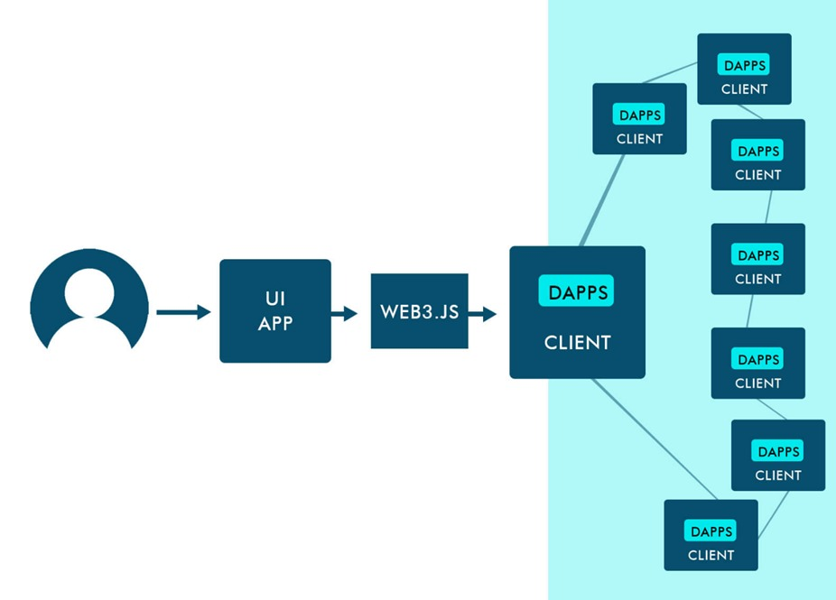
FUTURE SCOPE
This project includes deployment of blockchain technology
• This study uses a blockchain approach to solve the problem of product authenticity which can reduce the validation time of a product by a company.
• In future work, the blockchain approach in the case of other product authenticity requires more research so that this technology can be further implemented and developed.

Slide 10
CONCLUSION
In conclusion of the project, we would conclude that this project will provide a great help to future as discussed earlier. This project will be based on the Blockchain algorithms and full stack development. With the help of this project, authentication of the product can be done by providing proper information of the product on blockchain network. The project aims to reduce the false products from the market.

Slide 11
THANK YOU!
Abhishek Singh Yadav (2000290120011)
Aditi Batra (2000290120012)
Anurag Tripathi (2000290120036)

